Slide 1

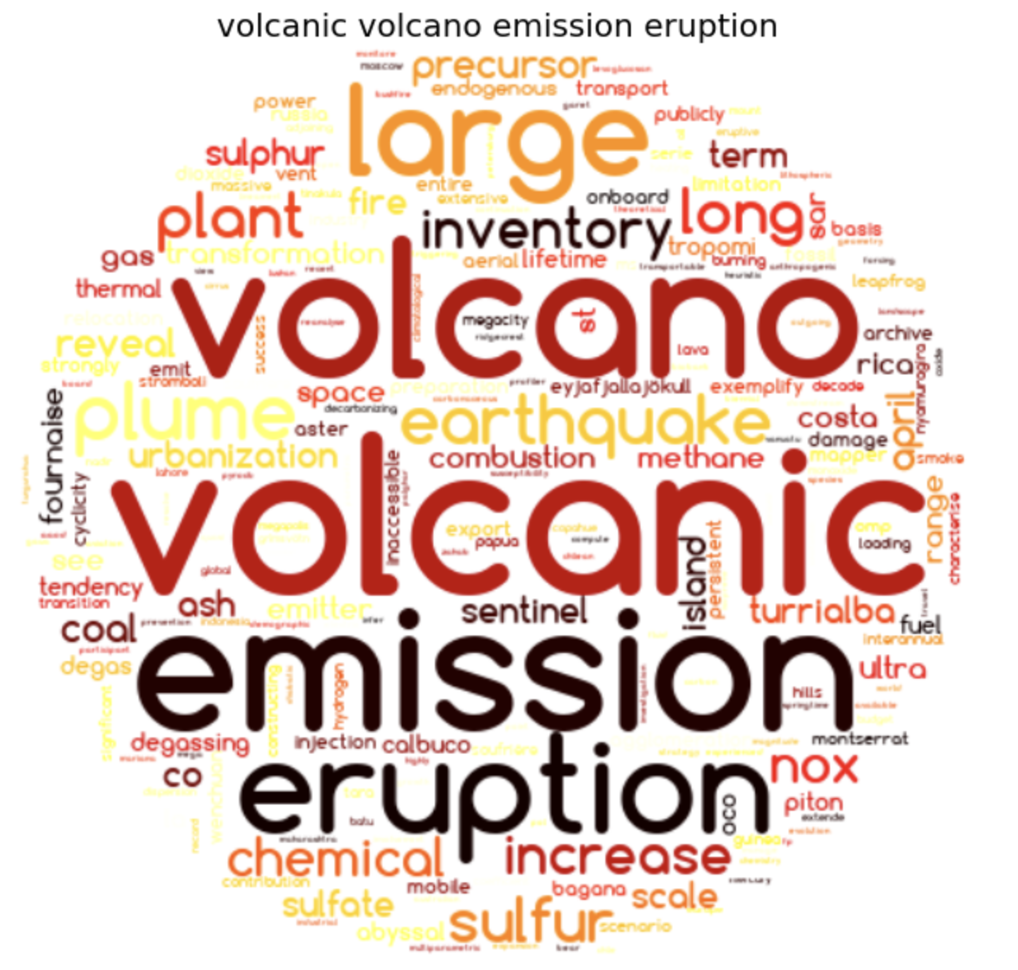
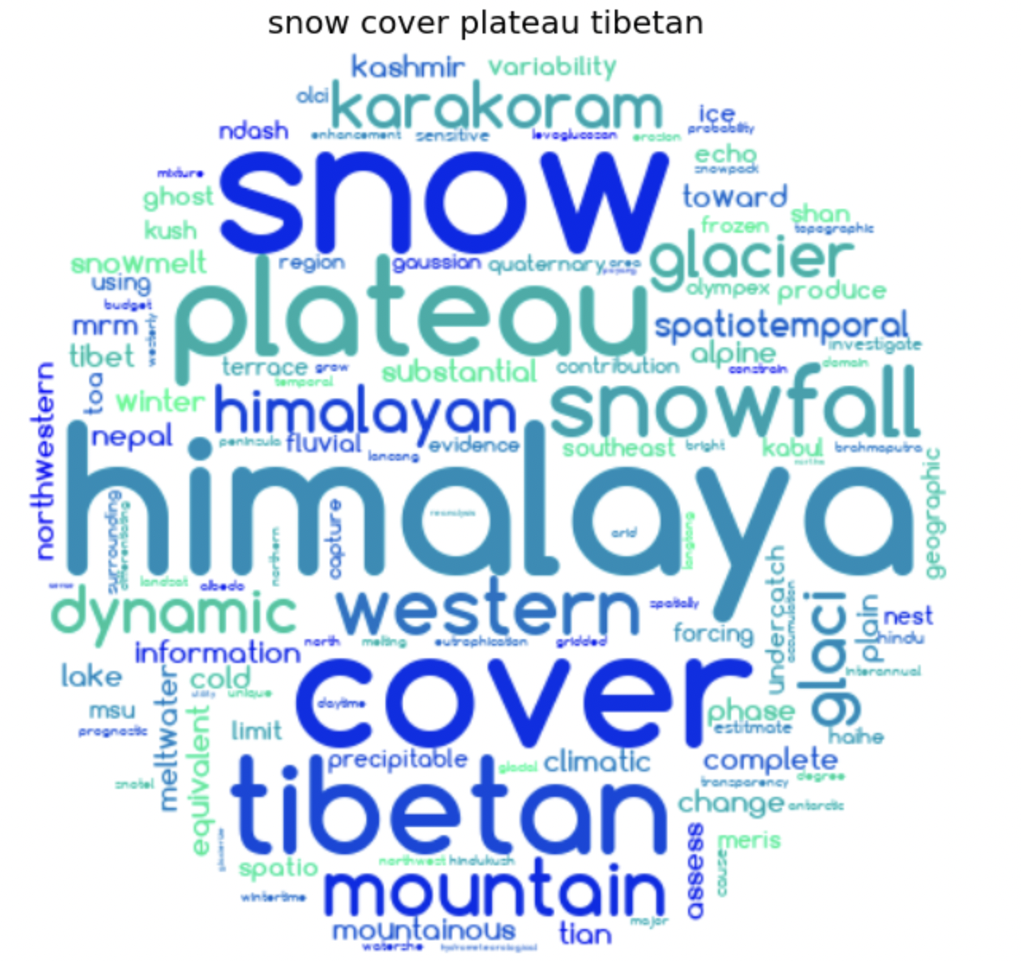
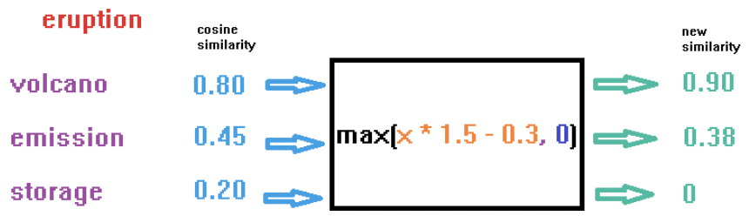

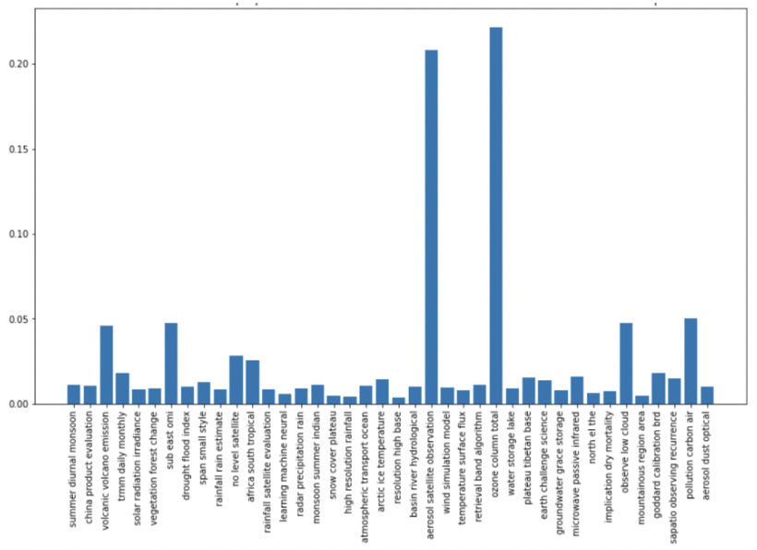
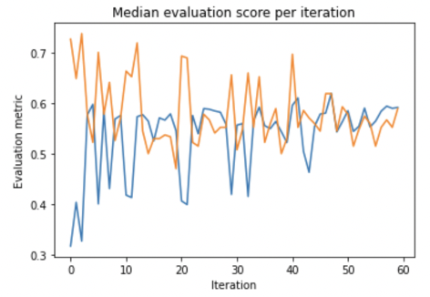
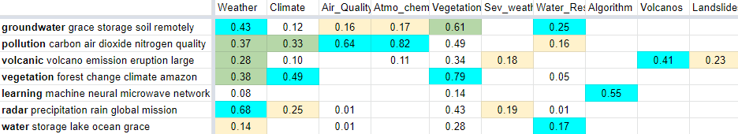
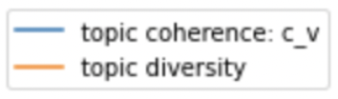
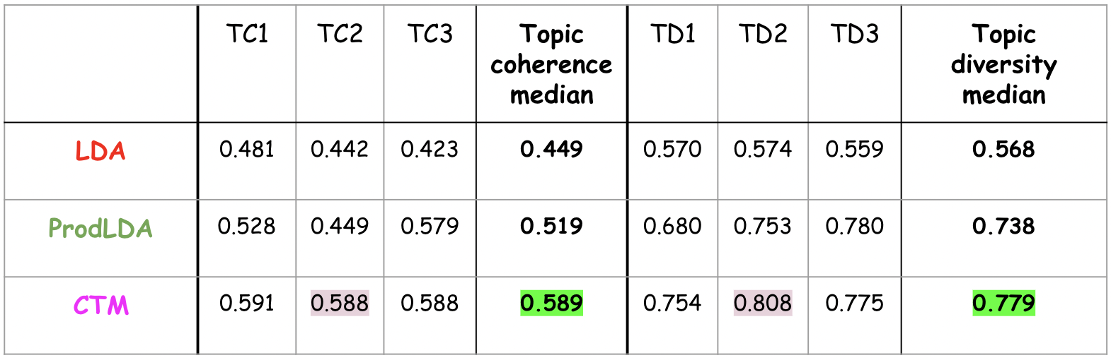
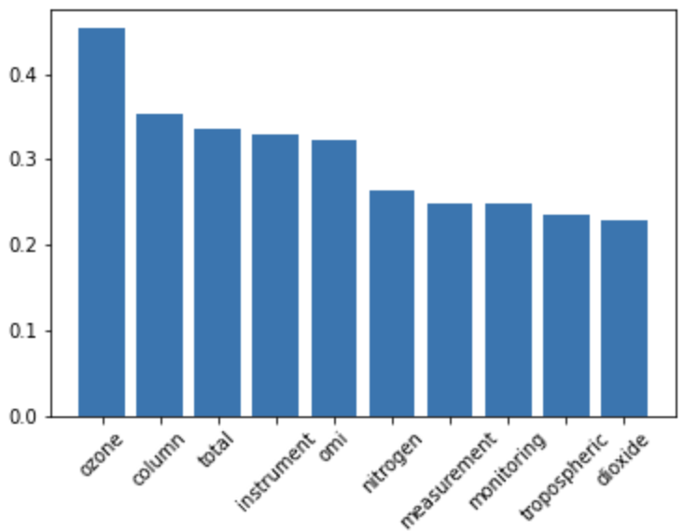
Topic Modeling: Using an Unsupervised Learning Method to Perform Classification of Publications
NASA Intern Symposium, Summer 2022
kevingao26@berkley.edu
MS TEAMS
August 10, 3pm EST
https://disc.gsfc.nasa.gov/
NASA/Goddard Earth Sciences Data and Information Services Center (GES DISC)
Kevin Gao^{1,2}, Irina Gerasimov^{1,2}, Armin Mehrabian^{1,2}, Mohammad Khayat^{1,2}, Binita KC^{1,2}, Jennifer Wei¹, and Long Pham¹
¹GES DISC, NASA Goddard Space Flight Center, Greenbelt, MD, USA ²ADNET Systems Inc., Lanham, MD, USA
Introduction
Topic Visualization
Linking generated topics to preassigned topics
We have a predefined list of topics that we would like to tag our publications with:
Dataset: 6,000 publications linked to GES-DISC datasets either by DOI or mentioning ShortName, using publication titles for topic modeling
Approach: use unsupervised learning (topic modeling) and automated method to map generated topics to predefined topics
Topic models are powerful tools that allow us to:
Generate topics each as as a collection of words (unlike classification, which requires a labeled dataset)
Each document will be comprised of many topics (unlike clustering, which creates a 1:1 mapping between topics and words
Word clouds for two of our 40 generated topics:
Words are not equal in a topic; larger words have greater influence in determining the topic.
2 step process:
Automatic: Use NLP to vectorize topics and compare with cosine similarity. Calculate a final score based on custom weighting function applied to similarity and list combinations. When determining final score,
Weight importance of each word by word weights minus a constant
Select and equally weight words in predefined topics
Use a custom function to remove “noise” from cosine similarity outputs, particularly in words with sim~=0.2 that should be 0:
Manual: Identify predefined topic lists that need to be re-defined (e.g. vegetation down, water resources up). Adjust output scores, create new topics, customize!
Optimized Model Results
Goal: optimize the hyperparameters to get the best performance possible from each model
Evaluation metrics:
Topic coherence: degree of semantic similarity between words in the topic
Topic diversity: how different the topics are
Process: Run optimizer through thousands of combinations of hyperparameters to optimize models on evaluation metrics
The prevalence of each topic in a publication “Seasonal variation of tropospheric bromine monoxide over the Rann of Kutch salt marsh seen from space”:
Topic #1 (p=0.24) : ozone column total …
Topic #2 (p=0.21) : aerosol satellite flux …
Summary
Goal: Able to tag our publications with the predefined topics they belong to (with confidence).
Apply unsupervised learning to determine topics of our publications, e.g. topic modeling.
Increase performance (topic coherence + diversity) by tuning the hyperparameters for a variety of topic models and select the best performing model (CTM).
Use word embeddings and cosine similarity to create a mapping from generated to the predefined topics.
Distribution of word weights that form a topic.
Our study found Contextualized Topic Models (CTM) to perform best on our publications and we used the 2nd run as our final model.

